Slide 1
Build your own Wi-Fi automation lab Lab Guide - Day 1
Andreas Koksrud / Telenor Bedrift
Kjetil Teigen Hansen / Conscia

Slide 2
References / inspiration
References
https://github.com/CiscoDevNet/yangsuite/
https://postman.com
https://docs.ansible.com/ansible/latest/collections/cisco/ios/ios_facts_module.html
https://www.wifireference.com/2020/01/14/viewing-network-telemetry-from-the-catalyst-9800-with-grafana/
https://grafana.com/grafana/dashboards/13462-device-health-monitoring/
https://grafana.com/grafana/dashboards/12468-catalyst-9800-client-stats/
https://wirelessisfun.wordpress.com/2020/12/10/network-telemetry-data-and-grafana-part-1-the-advanced-netconf-explorer/
https://python.org
https://codeium.com

Slide 3
Copyright
Copyright
© Andreas Koksrud 2024. All rights reserved. This presentation is provided for educational and informational purposes only. You may distribute and learn from this presentation, but commercial use or any form of monetization is strictly prohibited without prior written consent.

Slide 4
Prerequisites
Communications
Cisco.com account with access to downloading WLC (9800-CL at https://software.cisco.com)
Postman account (https://postman.com)
Windows laptop with administrative privileges
Complete the pre-lab exercises before the deep dive labs
Pre-lab exercises are distributed in a separate PowerPoint document Build your own Wi-Fi automation lab - Pre-lab tasks (2024-xx-xx).pptx
Without these, parts of the Deep Dive might be difficult to complete, or steps might differ severely

Slide 5

Communications
Communications
WebEx space: Wi-Fi automation lab
Please help each other
Sharing is caring ☺

Slide 6
Agenda
Agenda
Pre-lab
Install VirtualBox
Install Cisco 9800-CL
Install Ubuntu Server w/Docker
Install Postman
Install VS Code
Day 1
Get to know the lab environment
Day 2
In-depth explore a topic of choice
Sort out pre-lab task problems
Configure your AP
Install and explore YANG Suite
Explore Postman
Install and explore Grafana
Grafana / TIG-stack
Grafana Cloud
Ansible
Python
Other vendors (MIST/Meraki/Aruba)
Connect VS Code to Ubuntu
Install and explore Ansible
Explore Python automation

Slide 7
Scope
Scope
In scope
Getting started with various systems/languages/solutions for lab purposes
Get a lab environment up and running on your own laptop
Some nice examples to try various aspects of automation
Inspiring you to explore deeper on your own
Out of scope topics
Git
Learning the languages (Ansible, Python, InfluxQL, etc)
Learning Linux
Deploying the systems for production use

Slide 8
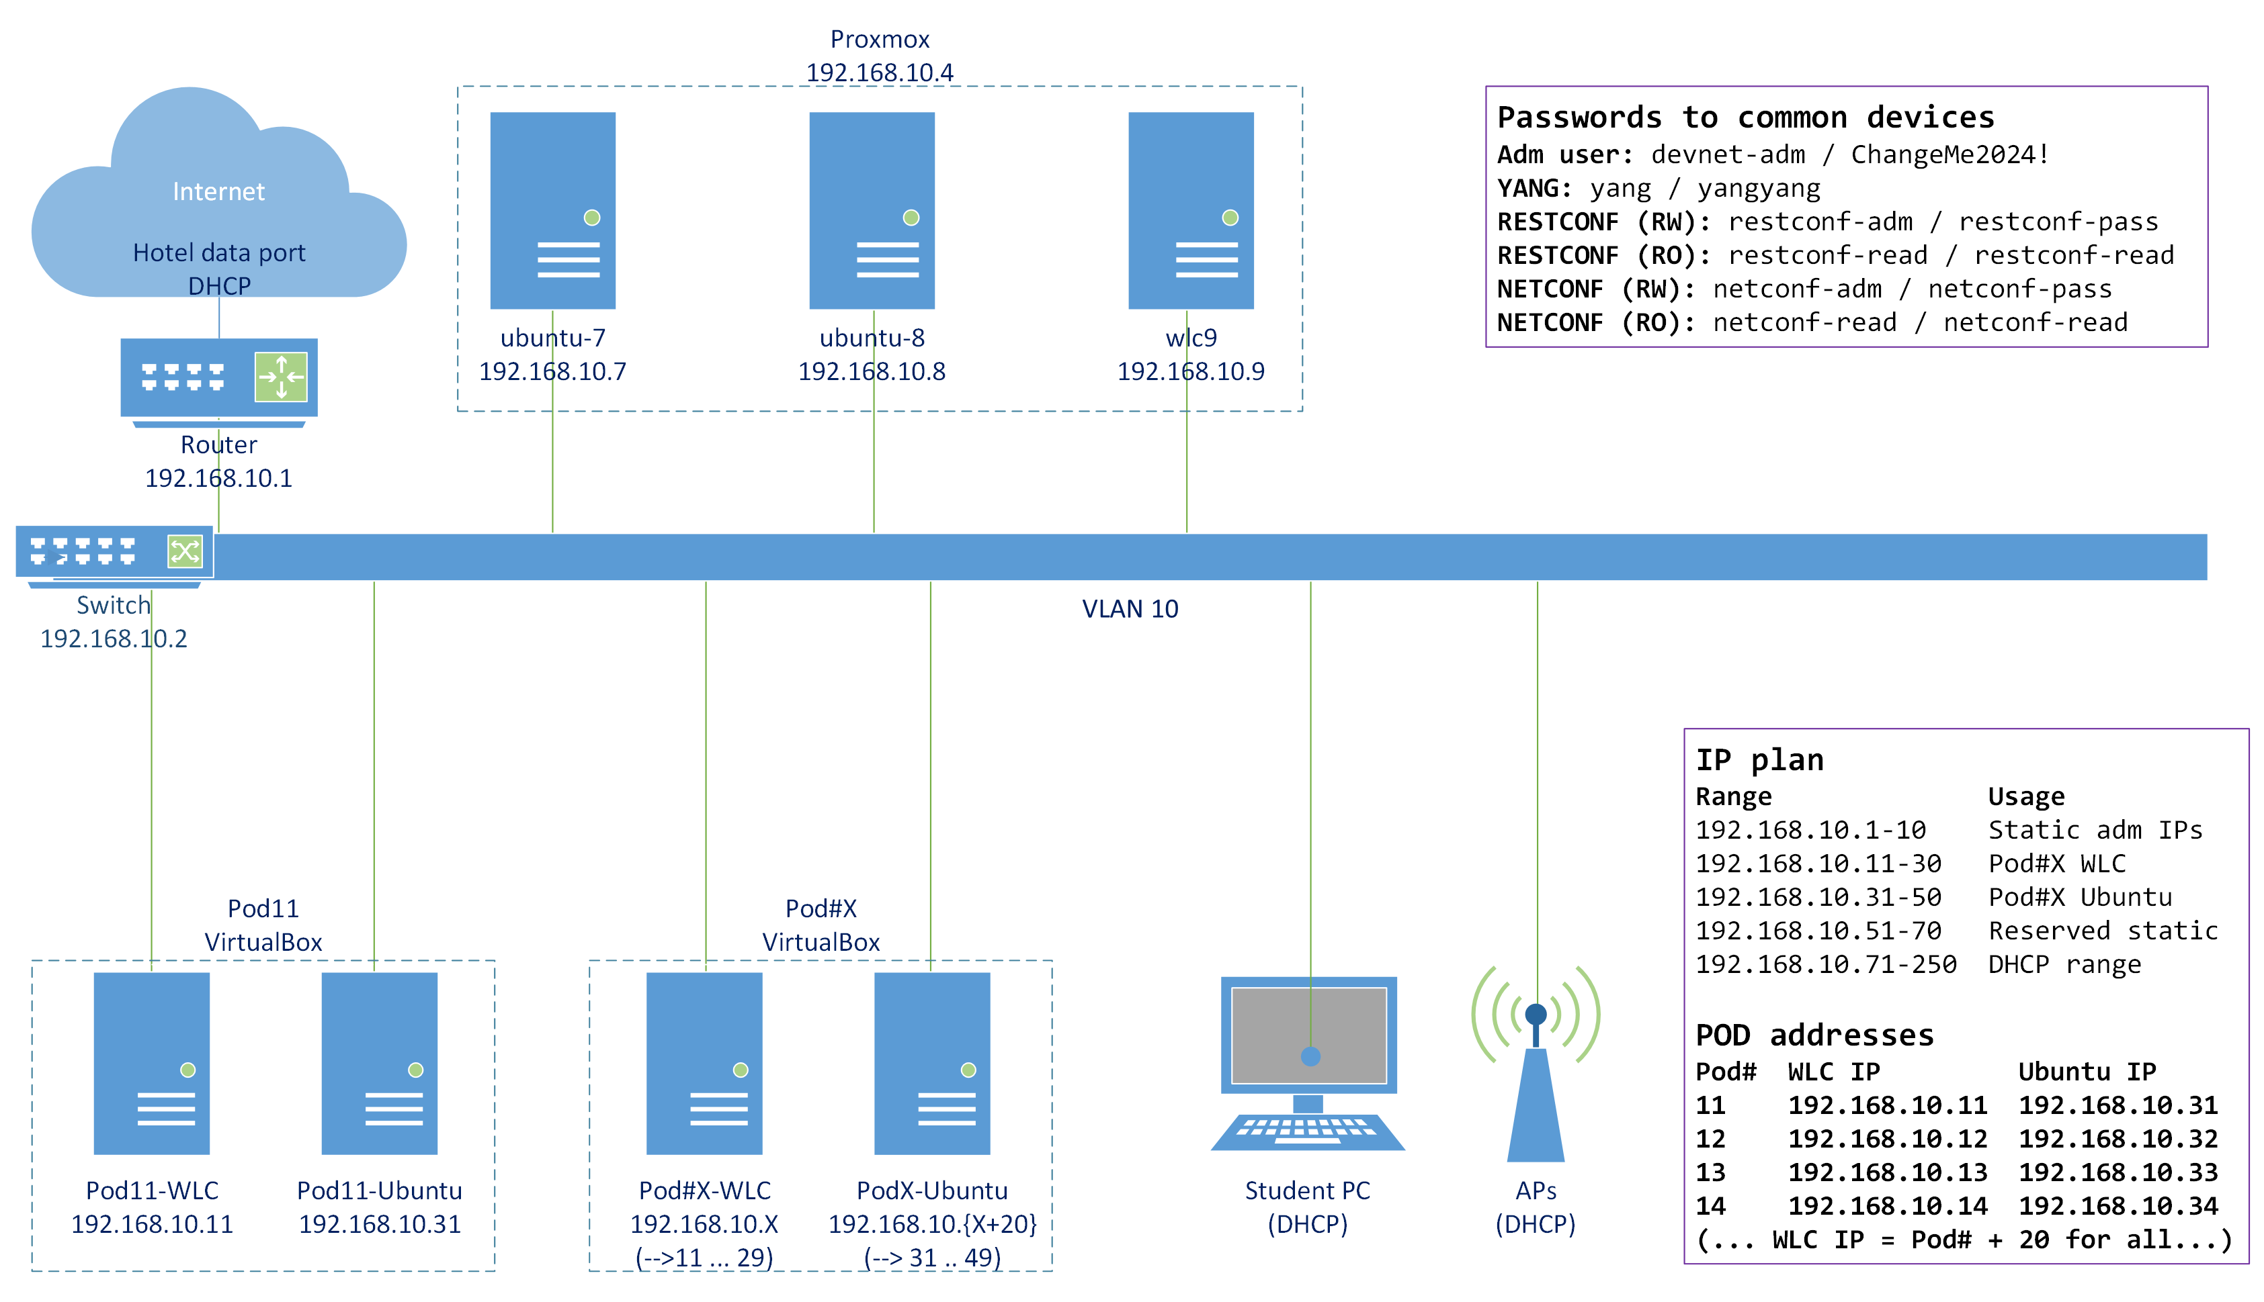
Topology
Lab topology

Slide 9
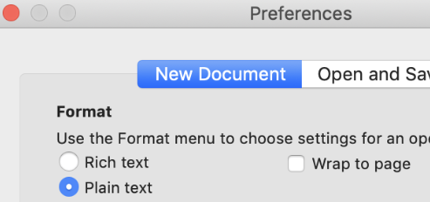
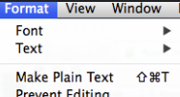
Notes for Mac users - TextEdit
Notes for Mac users
TextEdit (the default text editor on OS X) use rich text formatting by default. This is not a great idea when copy-pasting stuff to the command line, so there is a couple of things you must keep in mind
If you want, you can change a setting in TextEdit to make all new documents plain text
To change the current document to plain text go to Format -> Make Plain Text
Shortcut is: Shift-Cmd-T

Slide 10
I only want the "automation" part, not the "building your own lab" part
I only want the "automation" part, not the "building your own lab" part
If you for some reason do NOT want to do the "building your own automation lab" part of this deep dive, only the "a taste from the automation buffet" part, you can skip some parts. We will try to note those parts at the intro slide to each part.
In short, you can make these decisions to do less building and more automation
Use an Ubuntu server that we can host on a server that we bring along. This will be "your own" and we will delete it after the deep dive. The resources will be shared along with some other participants and the shared WLC
Use a C9800 WLC on a server that we bring along. This WLC will be shared by all students that need this. We might be able to host some more WLCs if neccessary
Instead of installing YANG Suite you can use it from a shared Ubuntu Server where it is already installed
Instead of installing the TIG stack (Grafana etc) you can use it from a shared Ubuntu Server where it is already installed
Please note that by doing this you might have more time for automation during the deep dive, but you will be less familiar with building the items yourself when you get home or need it in some other situation.

Slide 11
Tentative schedule for day 1
Tentative schedule
Hour 1
Finish the pre-lab tasks
Get to know the lab environment
Configure your AP
Install and explore Ansible
Hour 2
Explore Python automation
Install (optional) and explore YANG Suite
Explore Postman
Hour 3
Install and explore TIG-stack / Grafana

Slide 12
Lab exercise #0: Finish the pre-lab tasks
Lab exercise #0: Finish the pre-lab tasks
Get help to whatever you did not finish
There will probably (always) be some cases which falls outside what is tested

Slide 13
Lab exercise #1: Get to know the lab environment
Lab exercise #1: Get to know the lab environment
Connect your laptop to one of the ports in the switch
Ensure you get DHCP in the range 192.168.10.71-250 /24
Ensure you get internet access through the wired connection
Refer to the lab topology, and try the following
SSH to the shared Ubuntu servers (192.168.10.7 and .8)
SSH and HTTPS to the shared WLC (192.168.10.9)
SSH to the switch (192.168.10.2)
You have admin access to all shared devices, please don't mess up for each other ☺
Power up your VMs and ensure their access
Your Ubuntu should have access to your WLC
Both your Ubuntu and WLC should have internet access, and access to the shared servers
shared servers should have access to your servers

Slide 14

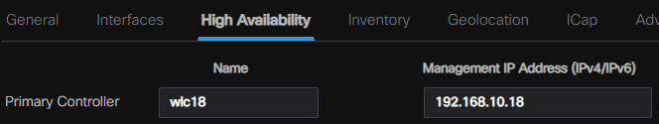
Lab exercise #2: Configure the AP
Lab exercise #2: Configure the AP
Get it connected to your WLC, or the shared WLC
Method #1: Connect to AP using console cable, set primary WLC
Example, for Pod#18 this would be:
Method #2: If your AP have joined another WLC, configure your WLC as primary controller
Ensure the AP shows up on your WLC, else troubleshoot... There should be Cisco experts somewhere in the room if needed ☺
APD42C-44D8-2F38#capwap ap primary-base wlc{pod-number} 192.168.10.{pod-number}
capwap ap primary-base wlc18 192.168.10.18

Slide 15
Lab exercise #3: Explore VS Code
Lab exercise #3: Explore VS Code
We will now use our VS Code installation to open a directory on the Ubuntu server
Instructions will follow to
Open the "Remote-SSH" extension
Create new host
Connect current window to remote host
Install local extensions in remote host
Open a remote folder as workspace
Open some example files from the downloaded GIT repository

Slide 16
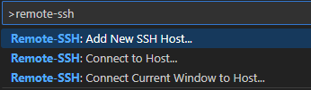
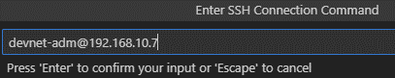
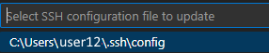
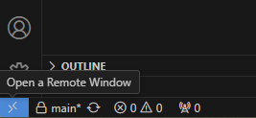
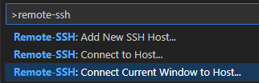
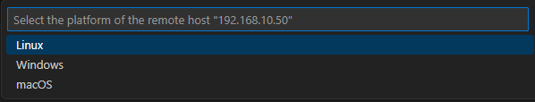
VS Code - Connect to... Remote SSH
Lab exercise #3: Explore VS Code
Replace with your Ubuntu IP
Command Palette (F1)
Type "remote-ssh", select "Add New SSH Host...", type "devnet-adm@192.168.10.7"
Connect to the new Host, either using lower left corner of VS Code window or Command Palette (F1)
When asked about platform type, select Linux

Slide 17
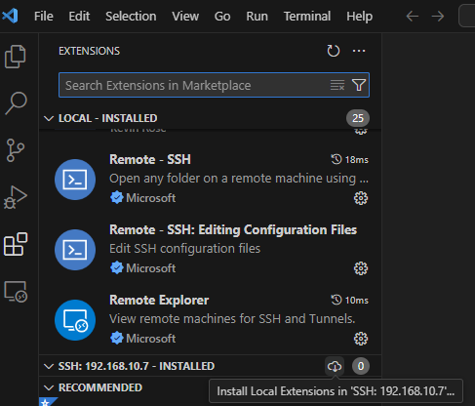
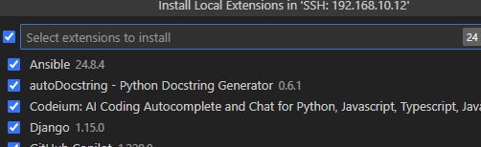
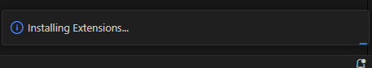
VS Code - Install Extensions in Remote SSH
Lab exercise #3: Explore VS Code
The extensions have to be installed in each remote environment
When asked which ones to install, you can select everything, or select some of them if you have a lot of extensions
It will take a minute or so to install the extensions in the server

Slide 18
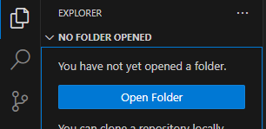
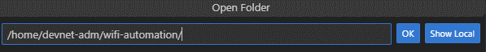
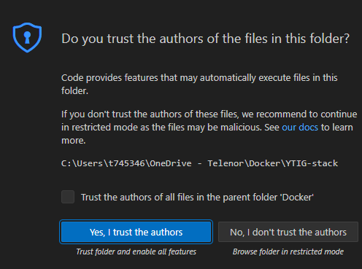
VS Code
Lab exercise #3: Explore VS Code
Open Folder
Trust authors

Slide 19
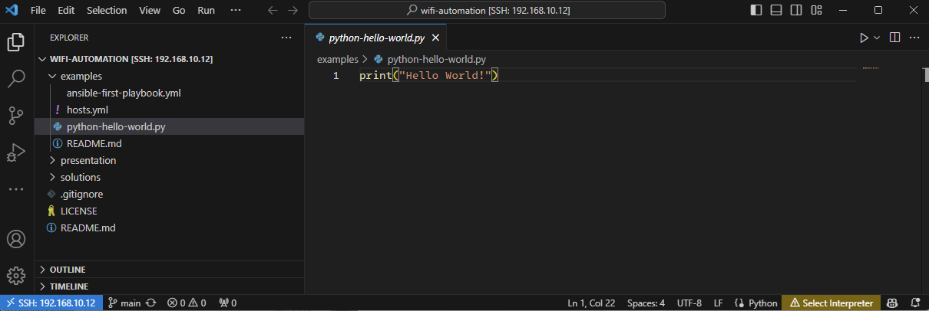
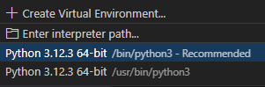
Lab exercise #3: Explore VS Code
Using Explorer in VS Code, open the example file python-hello-world.py
Detected language for active file
(can be manually overridden)
Active Python environment
for active file. Press here, and
for now select one of the options,
like /bin/python3

Slide 20
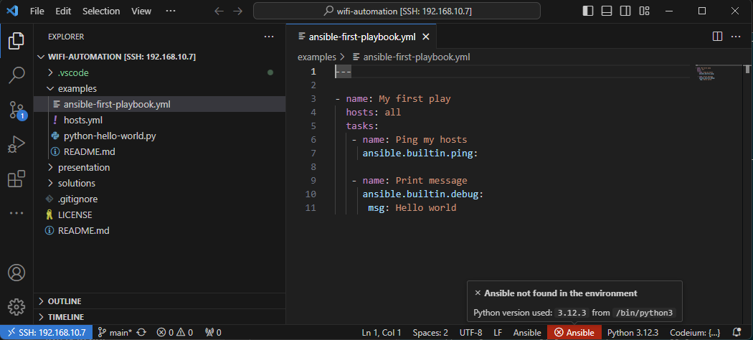
Lab exercise #3: Explore VS Code
If you open the Ansible file ansible-first-playbook.yml some errors will show. We will fix this later in the lab, after installing Ansible

Slide 21
Lab exercise #4: Install Ansible
Lab exercise #4: Install Ansible
In this exercise, we will
Create a Python virtual environment to use for Ansible stuff
Install Ansible on the Ubuntu Server
Configure VS Code to use Ansible on the remote server
The first couple of slides will explain briefly about Ansible (for your reference)
Then the installation process is explained step by step, before re-opening the first playbook example

Slide 22
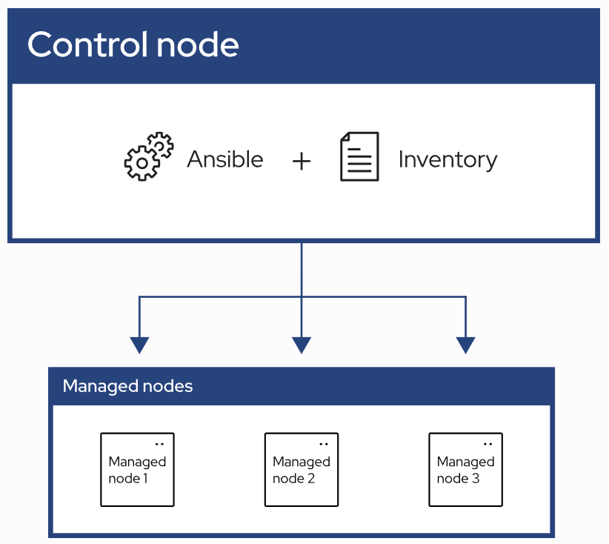
What is Ansible
Lab exercise #4: Install Ansible
Automation using "playbooks" written in YAML format
Agent-less architecture
No installation on the managed nodes
Idempotency
Does not change/write if target is already in state described by playbook
Control node
System where Ansible is installed and runs the playbooks
Inventory
List of managed nodes where the playbook will affect
Managed nodes
Remote systems that are the targets of your playbooks

Slide 23
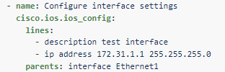
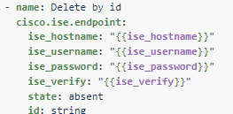
Plugins and modules
Lab exercise #4: Install Ansible
Plugins
Extends the core functionality of Ansible
Examples
cisco.ios.ios cliconf - To run CLI commands on Cisco IOS device
Become plugins, how to get write access on various systems ("sudo", "enable" etc)
Connection plugins, like SSH
Modules
Built-in or custom code snippets to perform various tasks
A special type of plugin
Examples
cisco.ios.ios_config
cisco.ise.endpoint

Slide 24
Ansible installation
Lab exercise #4: Install Ansible
Installing in a Python VENV (Virtual Environment)
(optional info) Ansible could be installed globally. But by using VENV we can control the environment more closely. Most projects will have some dependencies, and by controlling the environment you ensure that the packages in the environment are ones that is tested to be compatible with the project. Here we just use the latest, but it is shared to list ("freeze") the currently installed packages and versions from an environment when tested OK, and use this as a requirements input when reproducing the environment
devnet-adm@ubuntu-devnet:~$ sudo apt install pip python3-venv
devnet-adm@ubuntu-devnet:~$ mkdir ~/ansible-venv
devnet-adm@ubuntu-devnet:~$ python3 -m venv ~/ansible-venv/
devnet-adm@ubuntu-devnet:~$ source ~/ansible-venv/bin/activate
(ansible-venv) devnet-adm@ubuntu-devnet:~$ pip install ansible ansible-lint
(ansible-venv) devnet-adm@ubuntu-devnet:~$ ansible --version
ansible [core 2.17.1]
config file = None
configured module search path = ['/home/devnet-adm/.ansible/plugins/modules', '/usr/share/ansible/plugins/modules']
ansible python module location = /home/devnet-adm/ansible-venv/lib/python3.12/site-packages/ansible
ansible collection location = /home/devnet-adm/.ansible/collections:/usr/share/ansible/collections
executable location = /home/devnet-adm/ansible-venv/bin/ansible
python version = 3.12.3 (main, Apr 10 2024, 05:33:47) [GCC 13.2.0] (/home/devnet-adm/ansible-venv/bin/python3)
jinja version = 3.1.4
libyaml = True
(ansible-venv) devnet-adm@ubuntu-devnet:~$

Slide 25
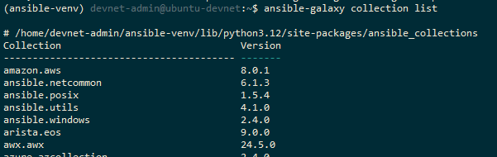
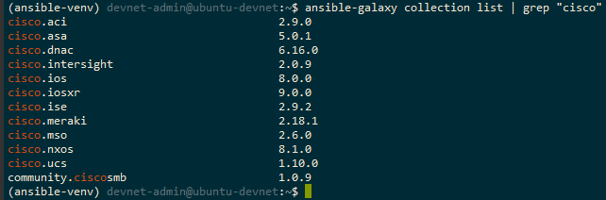
Ansible Collections
Lab exercise #4: Install Ansible
Installing in a Python VENV (Virtual Environment)
https://docs.ansible.com/ansible/latest/collections/index.html#list-of-collections
This is how to look up which collections you have installed in your environment

Slide 26
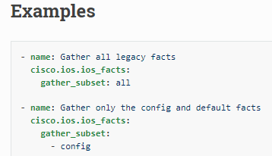
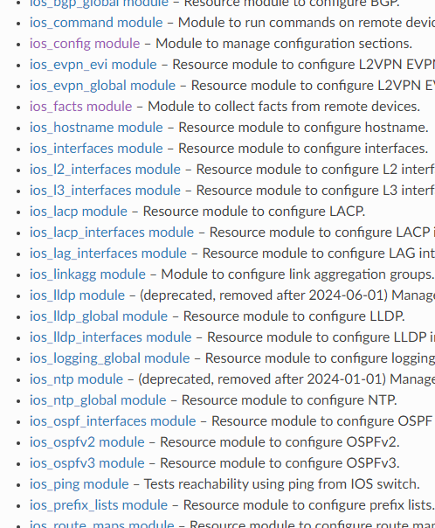
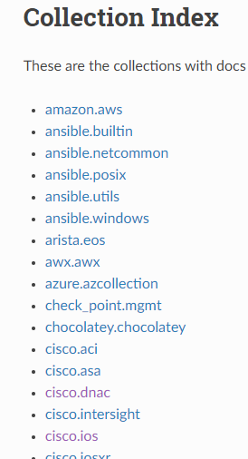
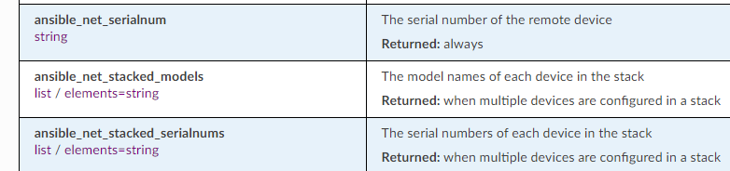
Ansible Collections
Lab exercise #4: Install Ansible
Navigating the documentation
https://docs.ansible.com/ansible/latest/collections/index.html#list-of-collections

Slide 27
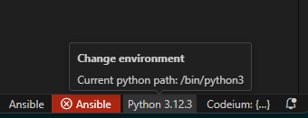
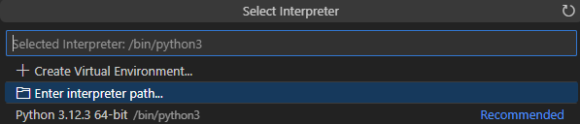
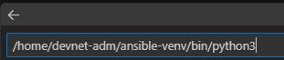
VS Code - Python environment for Ansible
Lab exercise #4: Install Ansible
Check which Python environment is used by Ansible
Select python environment (VS Code, bottom line)
Select «Enter interpreter path...»
Enter the python environment that Ansible use, into this line and press Enter
Bottom line should now show the Ansible version (2.17.3) and Python version and venv
devnet-adm@ubuntu-devnet:~$ source ~/ansible-venv/bin/activate
(ansible-venv) devnet-adm@ubuntu-devnet:~$ ansible --version | grep "python version"
python version = 3.12.3 (main, Apr 10 2024, 05:33:47) [GCC 13.2.0] (/home/devnet-adm/ansible-venv/bin/python3)
/home/devnet-adm/ansible-venv/bin/python3

Slide 28
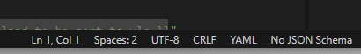
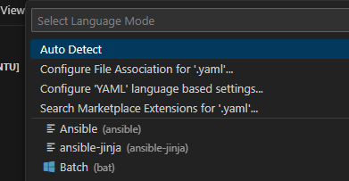
VS Code - Choose file type
Lab exercise #4: Install Ansible
If not auto detected, file type can be changed for open files
Tips: If the file name contains the word «playbook», it will automatically be recognized as Ansible by VS Code (and not general YAML)
interface-playbook.yaml
demo-playbook.yaml

Slide 29
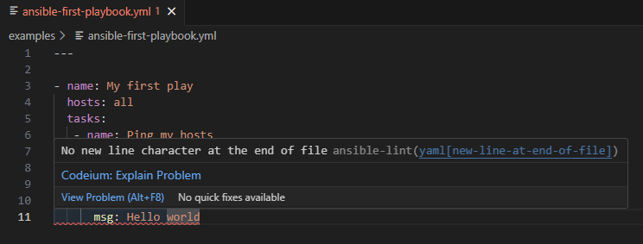
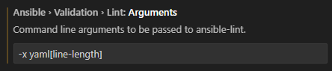
Ansible-lint
Lab exercise #4: Install Ansible
Linting (syntax checking) is done on file save
The «ansible-first-playbook.yml» should have an error that shows on first save, when ansible-lint runs in the background
Try to fix this yourself ☺
(optional info) You can also specify ansible-lint to exclude certain errors, like the "line too long" error.
Open Settings (Ctrl-,) and search for "ansible-lint" Enter -x yaml[line-length]

Slide 30
Lab exercise #5: Explore Ansible
Lab exercise #5: Explore Ansible
In this lab, you will be given a simple example to get you started with Ansible
The Ansible section of Day2 will include more exercises for you to do, including example solutions

Slide 31
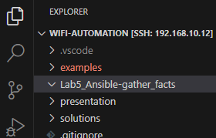
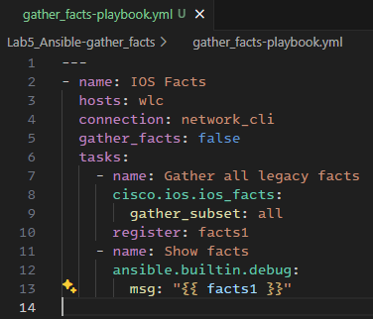
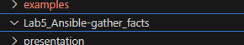

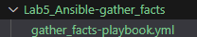
Gather facts
Lab exercise #5: Explore Ansible
gather_facts-playbook.yml
---
- name: IOS Facts
hosts: wlc
connection: network_cli
gather_facts: false
tasks:
- name: Gather all legacy facts
cisco.ios.ios_facts:
gather_subset: all
register: facts1
- name: Show facts
ansible.builtin.debug:
msg: "{{ facts1 }}"
Create a folder
Shows up automatically in VS Code
Create files and folders in VS Code, right click to get menu
Create the file "gather_facts-playbook.yml"
Copy-paste from this textbox to VS Code
(ansible-venv) devnet-adm@ubuntu-devnet:~/wifi-automation$ mkdir Lab5_Ansible-gather_facts

Slide 32
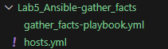
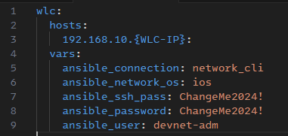
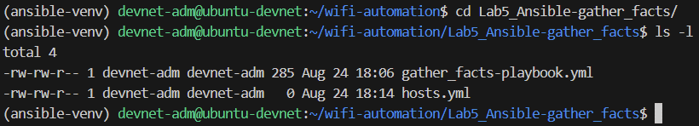
Ansible hosts file
Lab exercise #5: Explore Ansible
hosts.yml
wlc:
hosts:
192.168.10.{WLC-IP}:
vars:
ansible_connection: network_cli
ansible_network_os: ios
ansible_ssh_pass: ChangeMe2024!
ansible_password: ChangeMe2024!
ansible_user: devnet-adm
Let’s create a file named hosts.yml
It shows up in the folder as well
Change to YOUR
WLC IP

Slide 33
Fix dependencies
Lab exercise #5: Explore Ansible
Try to run the playbook with the following command. Something is missing.
(ansible-venv) devnet-adm@ubuntu-devnet:~/wifi-automation/Lab5_Ansible-gather_facts$ ansible-playbook -i hosts.yml gather_facts-playbook.yml
PLAY [IOS Facts] ***************************************************************************************************************************************
TASK [Gather all legacy facts] *************************************************************************************************************************
[WARNING]: ansible-pylibssh not installed, falling back to paramiko
fatal: [192.168.10.30]: FAILED! => {"changed": false, "msg": "paramiko is not installed: No module named 'paramiko'"}
PLAY RECAP *********************************************************************************************************************************************
192.168.10.30 : ok=0 changed=0 unreachable=0 failed=1 skipped=0 rescued=0 ignored=0
(ansible-venv) devnet-adm@ubuntu-devnet:~/wifi-automation/Lab5_Ansible-gather_facts$
Let's install "ansible-pylibssh"
First, make sure you are in your ansible-venv
If it is not showing (ansible-venv) at the start of the line, enter "source ~/ansible-venv/bin/activate"
Then install the package in your venv by using "pip install {package name}
(ansible-venv) devnet-adm@ubuntu-devnet:~$ pip install ansible-pylibssh
Collecting ansible-pylibssh
Downloading ansible_pylibssh-1.2.2-cp312-cp312-manylinux_2_28_x86_64.whl.metadata (36 kB)
Downloading ansible_pylibssh-1.2.2-cp312-cp312-manylinux_2_28_x86_64.whl (2.9 MB)
━━━━━━━━━━━━━━━━━━━━━━━━━━━━━━━━━━━━━━━━ 2.9/2.9 MB 7.1 MB/s eta 0:00:00
Installing collected packages: ansible-pylibssh
Successfully installed ansible-pylibssh-1.2.2
(ansible-venv) devnet-adm@ubuntu-devnet:~$

Slide 34
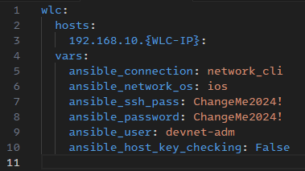
SSH host key checking
Lab exercise #5: Explore Ansible
Try running again. The SSH connection is failing
Update the hosts.yml file
(ansible-venv) devnet-adm@ubuntu-devnet:~/wifi-automation/Lab5_Ansible-gather_facts$ ansible-playbook -i hosts.yml gather_facts-playbook.yml
PLAY [IOS Facts] ***************************************************************************************************************************************
TASK [Gather all legacy facts] *************************************************************************************************************************
fatal: [192.168.10.30]: FAILED! => {"changed": false, "msg": "\nlibssh: The authenticity of host '192.168.10.30' can't be established due to 'Host is unknown: 41:86:3e:e4:fb:9f:de:06:5b:72:f3:ce:75:f1:da:ad:e7:a5:13:c0'.\nThe ssh-rsa key fingerprint is SHA1:QYY+5Puf3gZbcvPOdfHareelE8A."}
PLAY RECAP *********************************************************************************************************************************************
192.168.10.30 : ok=0 changed=0 unreachable=0 failed=1 skipped=0 rescued=0 ignored=0
Change to YOUR
WLC IP
hosts.yml
wlc:
hosts:
192.168.10.{WLC-IP}:
vars:
ansible_connection: network_cli
ansible_network_os: ios
ansible_ssh_pass: ChangeMe2024!
ansible_password: ChangeMe2024!
ansible_user: devnet-adm
ansible_host_key_checking: False

Slide 35
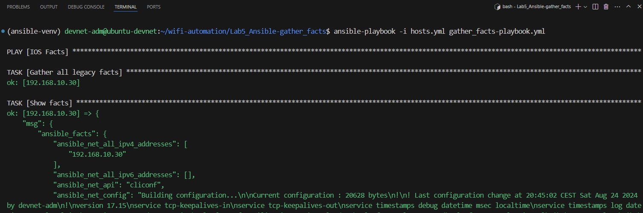
Gather facts
Lab exercise #5: Explore Ansible
Successful play

Slide 36
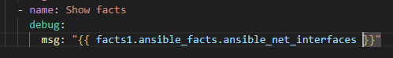
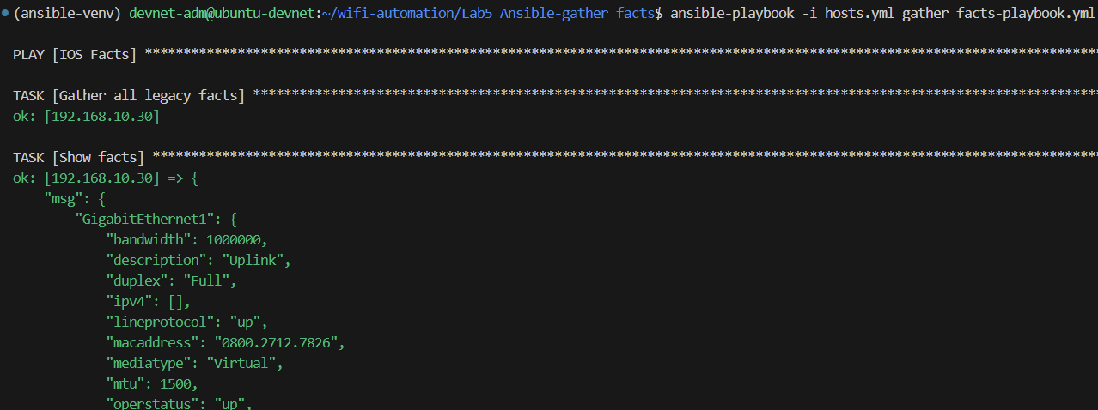
Use parts of return values
Lab exercise #5: Explore Ansible
The returned facts1 is a dictionary
You can use dot notation
Edit the "Show facts" task, to show only some subset of the info
- name: Show facts
debug:
msg: "{{ facts1.ansible_facts.ansible_net_interfaces }}"

Slide 37
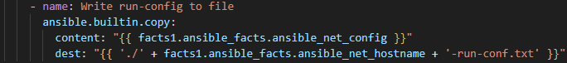
Use return values
Lab exercise #5: Explore Ansible
gather_facts-playbook.yml
---
- name: IOS Facts
hosts: wlc
connection: network_cli
gather_facts: no
tasks:
- name: Gather all legacy facts
cisco.ios.ios_facts:
gather_subset: all
register: facts1
- name: Write run-config to file
ansible.builtin.copy:
content: "{{ facts1.ansible_facts.ansible_net_config }}"
dest: "{{ './' + facts1.ansible_facts.ansible_net_hostname + '-run-conf.txt' }}"
We will use the returned facts, to write the run-config to a file
Remove the "Show facts" task, and replace it with a new task
Using the "copy" module
Content is using parts of the return values, this time we use "ansible_net_config"
Dest is where to write the content. Here are some simple examples on Jinja syntax
(optional info)
Jinja2 is integrated in Ansible and widely used
"Everything inside double curly brackets" = Jinja2

Slide 38
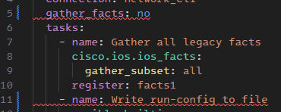
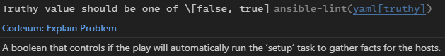
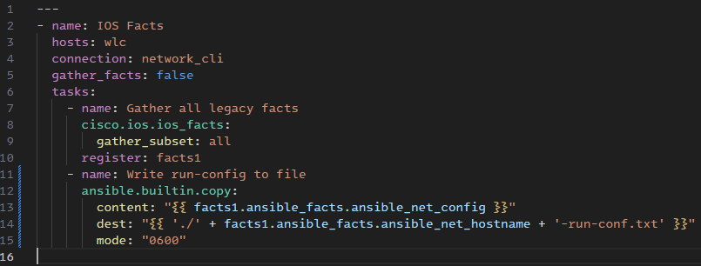
Linting errors, and fixing them
Lab exercise #5: Explore Ansible
gather_facts-playbook.yml
---
- name: IOS Facts
hosts: wlc
connection: network_cli
gather_facts: false
tasks:
- name: Gather all legacy facts
cisco.ios.ios_facts:
gather_subset: all
register: facts1
- name: Write run-config to file
ansible.builtin.copy:
content: "{{ facts1.ansible_facts.ansible_net_config }}"
dest: "{{ './' + facts1.ansible_facts.ansible_net_hostname + '-run-conf.txt' }}"
mode: "0600"
When saving this file you should get two linting errors
We fix this with using "false" instead of "no"
Both will work, but correct YAML syntax is "false"
When writing files (like using the "copy" module), you should always explicitly specify the file permissions
We add the line: mode: "0600"

Slide 39




Run the playbook
Lab exercise #5: Explore Ansible
List the files, and you can see the file that was created
You can view the file contents in the Linux terminal by running "cat", "more", "nano" or similar
You will also see the file in VS Code explorer and can open it from there

Slide 40
Lab exercise #6: Install YANG Suite (optional)
Lab exercise #6: Install YANG Suite
!!! NOTE !!!
If you do not want to use time on installing YANG Suite at this point, you can use the already prepared YANG Suite installation on one of the shared servers:
https://192.168.10.7:8443
https://192.168.10.8:8443
You can skim through the following slides and continue from Lab Exercise 8
The first couple of slides will explain a little about YANG models and YANG Suite
Then, installation of YANG Suite as a docker container is explained
After successful installation, you can connect to YANG Suite on
https://{your Ubuntu IP}:8443
Then you will use YANG Suite to pull the YANG models from your own WLC

Slide 41

What is a YANG-model?
Lab exercise #6: Install YANG Suite
Structured representation of cfg og oper data
Used primarily with NETCONF & RESTCONF
Do you recognize what the tree is showing?
Reference/download: https://github.com/YangModels/yang/tree/main/vendor/cisco/xe/17121

Slide 42


YANG Suite
Lab exercise #6: Install YANG Suite

Slide 43
YANG Suite installation
Lab exercise #6: Install YANG Suite
Installation (requires Docker installed)
(...appx 4-5min depending on your VM speed)
While waiting, please carry on to the next slides ☺
Reference: https://developer.cisco.com/yangsuite/
!!! Note: This will create problems if you try to use YANG Suite if you have changed the IP of your Ubuntu server to something else. In that case, delete YANG Suite and reinstall !!!
To delete, use rm -R ~/yangsuite
devnet-adm@ubuntu-devnet:~$ cd ~
devnet-adm@ubuntu-devnet:~$ git clone https://github.com/CiscoDevNet/yangsuite
devnet-adm@ubuntu-devnet:~$ cd yangsuite/docker/
devnet-adm@ubuntu-devnet:~/yangsuite/docker$ ./start_yang_suite.sh
Hello, please setup YANG Suite admin user.
username: devnet-adm
password: ChangeMe2024!
confirm password: ChangeMe2024!
Will you access the system from a remote host? (y/n): y
Enter local host FQDN or IP: 192.168.10.7
Setup test certificates? (y/n): y
##################################################
## Generating self-signed certificates ##
(....)
email: devnet-adm@test.com
Setup test certificates? (y/n): y
(...blah blah blah)
Change this to your Ubuntu IP
From here you can just press Enter-Enter-Enter

Slide 44


Run in detached mode
Lab exercise #6: Install YANG Suite
When you get this output, it is ready to run
To "free up" the command line, press Ctrl+C to stop YANG Suite
Then, to start the container in "detached" mode:
Access via HTTPS: https://{Your Ubuntu IP}:8443
devnet-adm@ubuntu-devnet:~$ cd ~/yangsuite/docker/
devnet-adm@ubuntu-devnet:~/yangsuite/docker/$ docker compose up -d

Slide 45


YANG Suite EULA
Lab exercise #6: Install YANG Suite
devnet-adm
ChangeMe2024!

Slide 46

Create new device
Lab exercise #6: Install YANG Suite
Create new device
8

Slide 47






Create new device
Lab exercise #6: Install YANG Suite
Create new device
Use your WLC IP

Slide 48


Create repository and Yangset
Lab exercise #6: Install YANG Suite
Create default repository and Yangset
(this will take a couple of minutes, so just be patient, while waiting you can sneak-peek on the next slides)

Slide 49

Explore YANG models
Lab exercise #6: Install YANG Suite
«oper» -> Operational data
«cfg» -> Configuration and config data
Here is how the window looks
The next slides will show some models to explore in detail

Slide 50

YANG Suite
Lab exercise #6: Install YANG Suite
Explore YANG Models

Slide 51
A word about gNMI (optional)
Lab exercise #6: Install YANG Suite
Another programmatic interface (like NETCONF and RESTCONF)
gNMI is not covered in this lab, but instructions to enable is found in the link below
9800 programmability & telemetry (see the gNMI section)
https://www.cisco.com/c/en/us/td/docs/wireless/controller/9800/technical-reference/catalyst-9800-programmability-telemetry-deployment-guide.html

Slide 52


yangcatalog (optional)
Lab exercise #6: Install YANG Suite
Just for reference, here is another web-based way to look at the YANG models
https://www.yangcatalog.org/yang-search/module_details

Slide 53


Lab exercise #7: Explore YANG Suite
Lab exercise #7: Explore YANG Suite
Over the next pages, you will explore a few YANG models
Get config (YANG/JSON version)
Get AP summary
Get Clients
Just get somewhat familiar, you will use these in the next exercises (Postman, Python, Ansible, Grafana)
This will show you the model, not pull the actual data
To pull data we will use these models i Postman and Grafana later
(optional) You can also do RESTCONF and NETCONF calls to the device from YANG Suite
Protocols -> RESTCONF -> Find your module -> Generate API(s) -> Authorize -> Try it out -> Execute

Slide 54

Get config (YANG version)
Lab exercise #7: Explore YANG Suite

Slide 55

Get AP summary
Lab exercise #7: Explore YANG Suite

Slide 56

Get Client summary
Lab exercise #7: Explore YANG Suite

Slide 57
Lab exercise #8: Explore Postman
Lab exercise #8: Explore Postman
In this lab exercise we will
Create a Workspace
Create an Environment
Create a Collection
Test some queries found from YANG Suite
Output to CURL or Python
(optional …and time-consuming) Test some queries to Meraki, Aruba, MIST or Cisco Always-On labs
(specific instructions for this is not finished to Prague'24, will be added to the slide deck later)
Most "cloud native" vendors have good guides to get started using the APIs with Postman. So you could try creating your API key in the relevant dashboard, and get your inventory of APs.

Slide 58

Overview
Lab exercise #8: Explore Postman
1
2
3
RESTCONF path
YANG module
Xpath
Postman is a "go-to" tool for RESTCONF APIs. Some examples for automation is testing and validating RESTCONF calls to IOS-XE devices before implementing in Python, Ansible, etc.

Slide 59




Create Workspace
Lab exercise #8: Explore Postman

Slide 60





Create Environment
Lab exercise #8: Explore Postman
Activate the new environment ... and create some variables

Slide 61




Create Collection
Lab exercise #8: Explore Postman

Slide 62


A word about saving
Lab exercise #8: Explore Postman
This little orange dot means the file/tab/whatever is not saved
Use Ctrl+S to save the current tab, or click this icon
An example: When you run a RESTCONF call with variables from an environment, like {{host}} or {{password}} it will use the value from your SAVED file. So if you do changes in the environment, remember to save the tab

Slide 63




Get config
Lab exercise #8: Explore Postman
Use without the forward slash (/)
Create the Postman queries based on the information explored from YANG Suite
Restconf path: https://{{host}}/restconf/data/
YANG-module: Cisco-IOS-XE-native
Xpath: native
Combined request path for copy-paste:
https://{{host}}/restconf/data/Cisco-IOS-XE-native:native

Slide 64




Get AP summary
Lab exercise #8: Explore Postman
Create the Postman queries based on the information explored from YANG Suite
Restconf path: https://{{host}}/restconf/data/
YANG-module: Cisco-IOS-XE-wireless-access-point-oper
Xpath: access-point-oper-data/capwap-data
Combined request path for copy-paste:
https://{{host}}/restconf/data/Cisco-IOS-XE-wireless-access-point-oper:access-point-oper-data/capwap-data

Slide 65

Get client summary
Lab exercise #8: Explore Postman
Create the Postman queries based on the information explored from YANG Suite
Restconf path: https://{{host}}/restconf/data/
YANG-module: Cisco-IOS-XE-wireless-client-oper
Xpath: client-oper-data/shared-oper-data
Combined request path for copy-paste:
https://{{host}}/restconf/data/Cisco-IOS-XE-wireless-client-oper:client-oper-data/shared-oper-data
RESTCONF path
YANG module
Xpath
If no users are connected, the return is "No Content" (status code 204)

Slide 66





Output to Python
Lab exercise #8: Explore Postman
You can output the RESTCONF call as various code snippets by clicking the "Code" button
This can be used in your favorite Python editor, or just run it to test
You get this by hovering the mouse over the **** text in the Code snippet
Add "verify= False" to skip certificate checking on the host

Slide 67



Using Cisco DevNet Sandbox (optional)
Lab exercise #8: Explore Postman
In this lab we will use C9800-L running on VirtualBox
If you have time or want to do it later, you can also test against an always-on or on-demand Cisco IOS XE device at Cisco DevNet Sandbox
https://developer.cisco.com/learning/labs/intro-dnac-api/authentication/
Some always-on (RO) labs
Some reservable (RW) labs

Slide 68
Testing Aruba APIs (optional)
Lab exercise #8: Explore Postman
This section is unfortunately not finished yet
You may download the updated guide at a later stage, from https://github.com/akoksrud/wifi-automation
To test this on your own, here is a starting point: https://developer.arubanetworks.com/hpe-aruba-networking-central/docs/postman-collection

Slide 69
Testing Meraki APIs (optional)
Lab exercise #8: Explore Postman
This section is unfortunately not finished yet
You may download the updated guide at a later stage, from https://github.com/akoksrud/wifi-automation
To test this on your own, here is a starting point: https://developer.cisco.com/meraki/api-v1/getting-started/#getting-started

Slide 70
Testing MIST APIs (optional)
Lab exercise #8: Explore Postman
This section is unfortunately not finished yet
You may download the updated guide at a later stage, from https://github.com/akoksrud/wifi-automation
To test this on your own, here is a starting point: https://www.mist.com/documentation/using-postman/

Slide 71
Lab exercise #9: Explore Python automation
Lab exercise #9: Explore Python automation
In this exercise we will
Create a new python virtual environment (venv) for python lab-work
Connect VS Code to the Ubuntu server
Create a Python script that
Connects to the WLC using RESTCONF
Gets a table of currently connected APs on the WLC
Saves the AP list as an Excel file

Slide 72
Create Python venv
Lab exercise #9: Explore Python automation
Python venv for python files (not neccessarily the same as for ansible)
Deactivate the Ansible venv if applicable
Create a new venv for python lab work
(ansible-venv) devnet-adm@ubuntu-devnet:~/wifi-automation/Lab5_Ansible-gather_facts$ cd ~
(ansible-venv) devnet-adm@ubuntu-devnet:~$ deactivate
devnet-adm@ubuntu-devnet:~$ mkdir ./python-lab-venv
devnet-adm@ubuntu-devnet:~$ python3 -m venv ./python-lab-venv
devnet-adm@ubuntu-devnet:~$ source ./python-lab-venv/bin/activate
(python-lab-venv) devnet-adm@ubuntu-devnet:~$ python --version
Python 3.12.3
(python-lab-venv) devnet-adm@ubuntu-devnet:~$ cd wifi-automation
(python-lab-venv) devnet-adm@ubuntu-devnet:~/wifi-automation$

Slide 73







Connect VS Code to the Ubuntu Server
Lab exercise #9: Explore Python automation
Use VS Code remote to the Ubuntu Server (if you are not already connected already)
Press the Remote SSH icon (lower left corner)
Then, in the top line, select "Connect current window to Host..."
Select your host, or configure a new (see earlier slides)
Select "Open Folder" in the Explorer section
Select "/home/devnet-adm/wifi-automation/" and click OK
Select the "python-lab-venv" venv: Click the venv area on the bottom line (you may have to open a .py file for this to show)
~/python-lab-venv/bin/python3

Slide 74
Create the Python file
Lab exercise #9: Explore Python automation
Create a folder "Lab9_Python-get-ap-table" and a python file "get-ap-table.py"
The new file will automatically open in the editor window

Slide 75

Prepare the RESTCONF calls
Lab exercise #9: Explore Python automation
Using Postman, test the RESTCONF calls to get this info from your WLC
This is the URL of the RESTCONF call we will be using in this exercise
https://{{host}}/restconf/data/Cisco-IOS-XE-wireless-access-point-oper:access-point-oper-data/capwap-data
You can try specifying some fields to reduce the data size
https://{{host}}/restconf/data/Cisco-IOS-XE-wireless-access-point-oper:access-point-oper-data/capwap-data?fields=wtp-mac;wtp-ip;name;ap-state;device-detail/static-info/board-data/wtp-serial-num;device-detail/static-info/board-data/wtp-enet-mac;device-detail/static-info/ap-models/model;tag-info/tag-source;tag-info/policy-tag-info;tag-info/site-tag;tag-info/rf-tag;tag-info/filter-info/filter-name;ap-time-info/boot-time;ap-time-info/join-time
In the next exercise we will install and use YANG Suite, where you can explore YANG models to find out URLs like this for "everything"

Slide 76

Prepare Python packages
Lab exercise #9: Explore Python automation
For this exercise, we will use the following modules
requests
pandas
openpyxl
To install these, use the command "pip install requests pandas openpyxl"
If you want, you can wait installing these until you see the errors highlighted in VS Code when we try to use them
(python-lab-venv) devnet-adm@ubuntu-devnet:~/wifi-automation$ cd Lab9_Python-get-ap-table
(python-lab-venv) devnet-adm@ubuntu-devnet:~/wifi-automation/Lab9_Python-get-ap-table$ pip install requests pandas openpyxl
Collecting requests
Downloading requests-2.32.3-py3-none-any.whl.metadata (4.6 kB)
Collecting pandas
Downloading pandas-2.2.2-cp312-cp312-manylinux_2_17_x86_64.manylinux2014_x86_64.whl.metadata (19 kB)
Collecting openpyxl
(...)
Successfully installed certifi-2024.7.4 charset-normalizer-3.3.2 et-xmlfile-1.1.0 idna-3.8 numpy-2.1.0 openpyxl-3.1.5 pandas-2.2.2 python-dateutil-2.9.0.post0 pytz-2024.1 requests-2.32.3 six-1.16.0 tzdata-2024.1 urllib3-2.2.2
(python-lab-venv) devnet-adm@ubuntu-devnet:~/wifi-automation/Lab9_Python-get-ap-table$

Slide 77

Get AP table
Lab exercise #9: Explore Python automation
get-ap-table.py
import requests
import pandas as pd
import getpass
wlc = input("Enter WLC IP: ")
user = input("Enter user: ")
password = getpass.getpass("Enter password: ")
url = f"https://{wlc}/restconf/data/Cisco-IOS-XE-wireless-access-point-oper:access-point-oper-data/capwap-data?fields=wtp-mac;wtp-ip;name;ap-state;device-detail/static-info/board-data/wtp-serial-num;device-detail/static-info/board-data/wtp-enet-mac;device-detail/static-info/ap-models/model;tag-info/tag-source;tag-info/policy-tag-info;tag-info/site-tag;tag-info/rf-tag;tag-info/filter-info/filter-name;ap-time-info/boot-time;ap-time-info/join-time"
payload = {}
headers = {
'Accept': 'application/yang-data+json',
'Content-Type': 'application/yang-data+json'
}
response = requests.get(url, auth=(user, password), headers=headers, data=payload, verify=False)
if (response.status_code==200):
ap_table = pd.json_normalize(response.json()['Cisco-IOS-XE-wireless-access-point-oper:capwap-data'])
print(ap_table)
ap_table.to_excel('ap_table.xlsx')
ap_table.to_csv('ap_table.csv')
else:
print(f"Status code: {response.status_code}: {response.reason}")
Import the modules we will use
WLC IP, username and password as input fields, it will be asked when running the script
Create the RESTCONF call using the IP of your WLC, and the path you tested with Postman
Make the call and save the response
Some very basic error checking
The response is given as JSON. We use a pandas function "json_normalize" to flatten parts of the JSON object to present it in a table
Print the table in the terminal
Save the table to Excel and CSV

Slide 78
Running the Python script from terminal
Lab exercise #9: Explore Python automation
One way to run a Python script, is by using the terminal. When in the folder of the script, run using "python" and the filename
(python-lab-venv) devnet-adm@ubuntu-devnet:~/wifi-automation$ cd Lab9_Python-get-ap-table
(python-lab-venv) devnet-adm@ubuntu-devnet:~/wifi-automation/Lab9_Python-get-ap-table$ ls -l
total 4
-rw-rw-r-- 1 devnet-adm devnet-adm 978 Aug 25 19:24 get-ap-table.py
(python-lab-venv) devnet-adm@ubuntu-devnet:~/wifi-automation/Lab9_Python-get-ap-table$ python get-ap-table.py
Enter WLC IP: 192.168.10.30
Enter user: devnet-adm
Enter password:
Use YOUR WLC IP
If there are no APs on the WLC it will have status code 204 (No Content). So it will not print the table etc, if it tried it would produce an error on the "json()[blablabla] part"
Status code: 204: No Content
Successful run will look something like this:
wtp-mac name wtp-ip ... ap-state.ap-operation-state ap-time-info.boot-time ap-time-info.join-time
0 4c:a6:4d:65:f9:40 9120E-ekms 192.168.10.182 ... registered 2024-07-25T00:28:12+00:00 2024-07-25T00:30:04.335182+00:00
1 d4:2c:44:d9:24:40 APD42C-44D8-2F38 192.168.10.177 ... registered 2024-07-31T19:22:07+00:00 2024-07-31T19:23:42.643078+00:00
Wrong username/password will look something like this:
Status code: 401: Unauthorized

Slide 79


Running the Python script from VS Code
Lab exercise #9: Explore Python automation
Press Ctrl+F5 to run the script in VS Code
Select "Python Debugger" if asked
The Excel file will contain the info, but will be otherwise unformatted (downloading the XLSX is not covered in this lab
You can open the CSV file in VS Code, or in the terminal using "cat ap_table.csv" (or several alternatives)

Slide 80

Lab exercise #10: Install TIG stack (optional)
Lab exercise #10: Install TIG stack
!!! NOTE !!!
This exercise is marked as optional. However, if you plan on doing more Grafana stuff on day to we highly recommend that you do this, even if it will take some extra time today, or continue on to day 2
If you plan doing primarily Python or Ansible stuff on day 2, you can skip exercise 10 (installing TIG stack) and skip to Lab exercise 11: Build your first Grafana dashboard just to get a small touch of the Grafana-magic ☺
In this lab exercise, we will install "TIG Stack" as a Docker container on the Ubuntu Server
As part of the installation we will
Create .env file containing variables
Ensure persistant storage
Create new bucket and adapt it so we can use InfluxDB
The next slides will give some basic overview of the TIG Stack, and how all fits together
T = Telegraf
I = InfluxDB
G = Grafana

Slide 81









TIG Stack overview
Lab exercise #10: Install TIG stack
gRPC / TCP 57000
C9800
metrics goes to the database
Wow!
TCP 8086
Grafana to visualize
WebUI - server:3000
TCP 3000

Slide 82



The TIG in the TIG stack
Lab exercise #10: Install TIG stack
Open Source Agent: Collects and sends metrics from databases, systems, and IoT devices
Versatile Monitoring: Works with databases, systems, and IoT sensors
Time Series Data at Scale: Store and query large volumes of time-stamped data
Real Time Analytics: Fast processing for immediate insights
Seamless Integration: Compatible with various tools and platforms
Visualize Anything: Create dashboards for any data
Real Time Insights: Customizable, interactive visuals
Flexible Integration: Connects to multiple data sources

Slide 83



Different flavours of Influx
Lab exercise #10: Install TIG stack
InfluxDB 2.x - FLUX
InfluxDB 1.x - InfluxQL
We will use InfluxDB 2.x but query data using InfluxQL
InfluxDB 3.x – InfluxQL (v2)

Slide 84
Make some notes
Lab exercise #10: Install TIG stack
There are some variables that need to be typed later, so to save time you can make a .txt file while we continue in this lab
Even better, you could use your favorite password manager (KeePass etc)
Lab10_Notes.txt
Admin token: {we will fill in this later}
Grafana token: {we will fill in this later}
Optional Telegraf token: {we will fill in this later}
Org ID: {we will fill in this later}
Container ID: {we will fill in this later}

Slide 85

TIG stack installation
Lab exercise #10: Install TIG stack
telegraf.conf
[global_tags]
host = "My-Telegraf"
[agent]
interval = "10s"
round_interval = true
metric_batch_size = 1000
metric_buffer_limit = 10000
collection_jitter = "0s"
flush_interval = "10s"
flush_jitter = "0s"
precision = ""
debug = false
quiet = false
logfile = ""
hostname = "My-Telegraf"
omit_hostname = false
###############################################################################
# OUTPUT PLUGINS #
###############################################################################
# Configuration for influxdb server to send metrics to
[[outputs.influxdb_v2]]
urls = [ "http://influxdb:8086" ]
token = "${INFLUXDB_ADMIN_TOKEN}"
organization = "${INFLUXDB_ORG}"
bucket = "${INFLUXDB_BUCKET}"
# tagexclude = ["influxdb_database"] ### Optional: Exclude specific tags if needed
[outputs.influxdb_v2.tagpass]
influxdb_database = ["${INFLUXDB_BUCKET}"]
###############################################################################
# INPUT PLUGINS #
###############################################################################
[[inputs.cisco_telemetry_mdt]]
transport = "grpc"
service_address = ":57000"
[inputs.cisco_telemetry_mdt.tags]
influxdb_database = "${INFLUXDB_BUCKET}"
Create a .env file to store variables
Add the INFLUXDB_ADMIN_TOKEN to your .txt file
Create persistant storage
Create the Telegraf config file
devnet-adm@ubuntu-devnet:~$ cd ~
devnet-adm@ubuntu-devnet:~$ mkdir tig-stack
devnet-adm@ubuntu-devnet:~$ cd tig-stack
devnet-adm@ubuntu-devnet:~/tig-stack$ nano .env
!
#add the following, and change the variables if needed
!
.env
INFLUXDB_ADMIN_USER=devnet-adm
INFLUXDB_ADMIN_PASSWORD=ChangeMe2024!
INFLUXDB_ORG=devnet
INFLUXDB_BUCKET=c9800-bucket
INFLUXDB_ADMIN_TOKEN=pleasechangeme2024
GF_SECURITY_ADMIN_USER=devnet-adm
GF_SECURITY_ADMIN_PASSWORD=ChangeMe2024!
devnet-adm@ubuntu-devnet:~/tig-stack$ docker volume create grafana-data
devnet-adm@ubuntu-devnet:~/tig-stack$ docker volume create influxdb-data
devnet-adm@ubuntu-devnet:~/tig-stack$ mkdir -p telegraf/conf
devnet-adm@ubuntu-devnet:~/tig-stack$ nano telegraf/conf/telegraf.conf

Slide 86
TIG stack installation
Lab exercise #10: Install TIG stack
docker-compose.yml
services:
influxdb:
container_name: influxdb
image: influxdb:2.7.10
expose:
- 8086
restart: always
volumes:
- influxdb-data:/var/lib/influxdb2
ports:
- 8086:8086
environment:
- DOCKER_INFLUXDB_INIT_MODE=setup
- DOCKER_INFLUXDB_INIT_USERNAME=${INFLUXDB_ADMIN_USER}
- DOCKER_INFLUXDB_INIT_PASSWORD=${INFLUXDB_ADMIN_PASSWORD}
- DOCKER_INFLUXDB_INIT_ORG=${INFLUXDB_ORG}
- DOCKER_INFLUXDB_INIT_BUCKET=${INFLUXDB_BUCKET}
- DOCKER_INFLUXDB_INIT_RETENTION=2w
- DOCKER_INFLUXDB_INIT_ADMIN_TOKEN=${INFLUXDB_ADMIN_TOKEN}
telegraf:
container_name: telegraf
image: telegraf:1.32.0
restart: always
ports:
- 57000:57000
env_file:
- .env
environment:
- INFLUXDB_TOKEN=${INFLUXDB_ADMIN_TOKEN}
- INFLUXDB_ORG=${INFLUXDB_ORG}
- INFLUXDB_BUCKET=${INFLUXDB_BUCKET}
volumes:
- ./telegraf/conf/telegraf.conf:/etc/telegraf/telegraf.conf:ro
- /var/run/docker.sock:/var/run/docker.sock
depends_on:
- influxdb
grafana:
container_name: grafana
image: grafana/grafana:11.1.4
expose:
- 3000
restart: always
ports:
- 3000:3000
environment:
- GF_SECURITY_ADMIN_USER=${GF_SECURITY_ADMIN_USER}
- GF_SECURITY_ADMIN_PASSWORD=${GF_SECURITY_ADMIN_PASSWORD}
- GF_INSTALL_PLUGINS=
volumes:
- grafana-data:/var/lib/grafana
#- ./grafana/grafana.ini:/etc/grafana/grafana.ini:ro
depends_on:
- influxdb
- telegraf
volumes:
grafana-data:
external: true
influxdb-data:
external: true
Configure docker-compose.yml
Add the following config to docker-compose.yml
Docker compose
This will take a few seconds to download all images.
To view logs from a service (telegraf, influxdb, grafana) use this
Connect to Grafana using web browser
Notice we use HTTP, not HTTPS for this lab install
http://192.168.10.{your Ubuntu IP}:3000
For now, just test that you can log in using the username and password from the .env file we created earlier. For this lab it will be the same as everywhere else unless you changed it ☺
devnet-adm@ubuntu-devnet:~$ cd ~/tig-stack
devnet-adm@ubuntu-devnet:~$ nano ./docker-compose.yml
devnet-adm@ubuntu-devnet:~$ docker compose up -d
devnet-adm@ubuntu-devnet:~$ docker logs telegraf

Slide 87


InfluxDB 2.X
Lab exercise #10.1: Install TIG stack, InfluxDB
http://192.168.10.{your Ubuntu IP}:8086
Username/password from .env file (same as always unless changed)
Notice that we here also use HTTP, not HTTPS
Change retention on your bucket to f.ex 31 days.

Slide 88


InfluxDB 2.X
Lab exercise #10.1: Install TIG stack, InfluxDB
http://192.168.10.{your Ubuntu IP}:8086
Create a an additonal bucket
Name it: syslog-bucket
Set retention to 30 days
You can find the bucket-ID here

Slide 89







(Optional) Create a new RO Token
Lab exercise #10.1: Install TIG stack, InfluxDB
Admin token
Token made in the .env file.
All access token (Read/Write to all databases)
Is needed to access InfluxDB in CLI
In a production environment you could create a separate token for Telegraf, with less privileges.
Read-only token
We will use this for Grafana
Update the text file
Lab10_notes.txt
Even better, use your password manager instead (KeePass etc)

Slide 90


Locate your Organization ID
Lab exercise #10.1: Install TIG stack, InfluxDB
InfluxDB > About
Note this down in the Lab10_notes.txt file

Slide 91


Locate your InfluxDB Docker container ID
Lab exercise #10.1: Install TIG stack, InfluxDB
Note this down in the Lab10_notes.txt file
devnet-adm@ubuntu-devnet:~/tig-stack$ docker ps -a --filter name=influxdb
CONTAINER ID IMAGE COMMAND CREATED STATUS PORTS NAMES
71b07ba58958 influxdb:2.7.10 "/entrypoint.sh infl…" 2 minutes ago Up 2 minutes 0.0.0.0:8086->8086/tcp, :::8086->8086/tcp influxdb
devnet-adm@ubuntu-devnet:~/tig-stack$
In the notes, you will then have
Admin token
Grafana token
Telegraf token (optional)
Org ID
Container IDs

Slide 92
InfluxDB 2.X: Query data in Grafana with InfluxQL
Lab exercise #10.1: Install TIG stack, InfluxDB
We will use the values from our lab notes
In v1 mode, it is called a "database«
What we have done here, is create a db which point to the same Bucket ID as the c9800-bucket
We now have
a c9800-bucket where we can query using FLUX
a c9800-db where we can query the same data, using InfluxQL
See earlier slide "Different flavors of InfluxDB"
Insert YOUR container-id
devnet-adm@ubuntu-devnet:~/tig-stack$ docker exec -it <your_container-id> bash
root@71b07ba58958:/# influx v1 dbrp list
Error: must specify org ID or org name
root@71b07ba58958:/# influx v1 dbrp list --org-id <your_org-id> --token <your_admin_token>
ID Database Bucket ID Retention Policy Default Organization ID
VIRTUAL DBRP MAPPINGS (READ-ONLY)
----------------------------------
ID Database Bucket ID Retention Policy Default Organization ID
b53d2ec9d932635a _monitoring b53d2ec9d932635a autogen true 6a6f13e3a65de450
09aac3a6cee8ab99 _tasks 09aac3a6cee8ab99 autogen true 6a6f13e3a65de450
574c74f705d86be2 syslog-bucket 294c74f678d86ab3 autogen true 6a6f13e3a65de450
574c74f705d86be2 c9800-bucket 574c74f705d86be2 autogen true 6a6f13e3a65de450
root@71b07ba58958:/# influx v1 dbrp create --db c9800-db --rp c9800-rp --bucket-id 574c74f705d86be2 --default --org-id <your_org-id> --token <your_admin_token>
root@71b07ba58958:/# influx v1 dbrp create --db syslog-db --rp syslog-rp --bucket-id 294c74f678d86ab3 --default --org-id <your_org-id> --token <your_admin_token>
ID Database Bucket ID Retention Policy Default Organization ID
0d94a420be168000 c9800-db bc926b463de1d39a c9800-rp true 6a6f13e3a65de450
root@71b07ba58958:/# exit
devnet-adm@ubuntu-devnet:~/tig-stack$
Insert YOUR org-id
Insert YOUR admin token
Repeat this step for the syslog-bucket

Slide 93
A bit about telemetry subscriptions
Lab exercise #10: Install TIG stack
Below are a couple of sample "telemetry subscriptions"'
Telemetry subscriptions are the same as Catalyst Center use to get telemetry data from IOS-XE devices
We will use telemetry subscriptions to get data from the 9800 over to our TIG stack (9800 -> Telegraf -> InfluxDB -> Grafana)
The syntax is inside configuration mode (conf t) on 9800
Each subscription has an ID
The filter is built from the YANG model
Update policy decide how often 9800 will push this to Telegraf (in 100ths of a second -> 500 = 5 sec)
Receiver IP is the IP of Telegraf (in this lab: your Ubuntu server)
You will not configure these now, they are only examples. We will use some other data ☺
telemetry ietf subscription 101
encoding encode-kvgpb
filter xpath /ios:native/version
stream yang-push
update-policy periodic 30000
receiver ip address 192.168.10.7 57000 protocol grpc-tcp
telemetry ietf subscription 102
encoding encode-kvgpb
filter xpath /process-cpu-ios-xe-oper:cpu-usage/cpu-utilization/five-seconds
stream yang-push
update-policy periodic 500
receiver ip address 192.168.10.7 57000 protocol grpc-tcp

Slide 94
Lab exercise #11: Build your first Grafana Dashboard
Lab exercise #11: Build your first Grafana Dashboard
In this exercise you will be hand-held to build your first dashboard in Grafana
The dashboard will be an AP Dashboard
More dashboards to be explored on day 2
A word of caution when making your first dashboards... don't use "Esc" key without saving, you might have to do some work again. You will probably do just that, and THEN learn it the hard way ☺
!!! Note !!!
If you are doing this lab exercise using TIG Stack on a shared server
Have a word with one of the instructors if there is any neccessary coordination or steps that differ
Replace "Your Ubuntu IP" with the respective IP of the shared server you are using
If you have your own WLC, do the next slide (WLC telemetry subsctiptions), then skip to slide 95 (Create your first Dashboard)
If you are using shared WLC, skip to slide 95 (Create your first Dashboard)

Slide 95
Add the following telemetry subscriptions on the WLC
Lab exercise #11: Build your first Grafana Dashboard
wlc9# conf t
telemetry ietf subscription 105
encoding encode-kvgpb
filter xpath /wireless-access-point-oper:access-point-oper-data/wireless-access-point-oper:ap-name-mac-map
stream yang-push
update-policy periodic 30000
receiver ip address 192.168.10.7 57000 protocol grpc-tcp
do show telemetry ietf subscription 105
Change this to your Ubuntu IP (or IP of the TIG stack you are using)
telemetry ietf subscription 106
encoding encode-kvgpb
filter xpath /wireless-rrm-oper:rrm-oper-data/wireless-rrm-oper:rrm-measurement/wireless-rrm-oper:load
stream yang-push
update-policy periodic 5000
receiver ip address 192.168.10.7 57000 protocol grpc-tcp
do show telemetry ietf subscription 106
Change this to your Ubuntu IP (or the IP of the TIG stack you are using)
telemetry ietf subscription 107
encoding encode-kvgpb
filter xpath /wireless-access-point-oper:access-point-oper-data/wireless-access-point-oper:radio-oper-data/wireless-access-point-oper:phy-ht-cfg
stream yang-push
update-policy periodic 5000
receiver ip address 192.168.10.7 57000 protocol grpc-tcp
do show telemetry ietf subscription 107

Slide 96



Grafana (http://{Ubuntu-IP}:3000)
Lab exercise #11: Build your first Grafana Dashboard
Add your first data source -> InfluxDB
Set a name for your database
Set Query language to InfluxQL
URL: http://influxdb:8086

Slide 97





Grafana (http://{Ubuntu-IP}:3000)
Lab exercise #11: Build your first Grafana Dashboard
Grafana needs to use a RO token to be able to read from the database, and InfluxDB password.
Use the Grafana token from Lab10 notes
Add a custom HTTP Headers
Header: Authorization
Value: Token <API-TOKEN>
There is a space between Token and <token>
Database: c9800-db
User/Pass: devnet-adm / ChangeMe2024!
!!! You should have 3 measurements found !!!

Slide 98





Create your first dashboard
Lab exercise #11: Build your first Grafana Dashboard
Grafana (http://{Ubuntu-IP}:3000)
!!! Don't press the very tempting "+Add Visualization" button yet, we will do some pre-work first ☺
Start by giving the new dashboard a name

Slide 99





Grafana
Lab exercise #11: Build your first Grafana Dashboard
Name: APName
Query:
Add variables
SHOW TAG VALUES WITH KEY = "wtp_name"

Slide 100



Grafana
Lab exercise #11: Build your first Grafana Dashboard
Create a new variable
Name: APMac
Show on dashboard: Nothing
Query:
Check if it is working with Run query
Press Apply
Then save your dashboard
SELECT distinct("wtp_mac") FROM "Cisco-IOS-XE-wireless-access-point-oper:access-point-oper-data/ap-name-mac-map" WHERE ("wtp_name" =~ /^$APName$/)

Slide 101



Grafana
Lab exercise #11: Build your first Grafana Dashboard
Go back to the Dashboard main page
Add visualization and make one using time series
"Time series" is automatically selected. If not, select it here

Slide 102


Grafana
Lab exercise #11: Build your first Grafana Dashboard
In the lower part of the screen, edit the query
Click "select measurement", you will get a menu of all measurements
Choose the Cisco-IOS-XE-wireless-rrm-oper:rrm-oper-data/rrm-measurement/load
(Optional) You can enter YANG Suite, find the Cisco-IOS-XE-wireless-rrm-oper module and explore which values you could get from this YANG model

Slide 103






Grafana
Lab exercise #11: Build your first Grafana Dashboard
To get the options, click the "+" signs, like here
You can search in the "Choose" field over the options
To specify the value inside the "field(value)" click it
Try to make the screen match this image
Add another row
To create an alias, choose "alias" and click the alias(alias) button
Type the name and press Enter

Slide 104





Grafana
Lab exercise #11: Build your first Grafana Dashboard
Set the panel title
Under graph styles you can make it look like you want ☺ Set Connect null values to always
Fix values to percent
In the field to the right, you have lots of options

Slide 105





Grafana
Lab exercise #11: Build your first Grafana Dashboard
You do not want number of clients to show as percent
We use an override for the Clients graph
Select the regex-override
Standard options > Unit
Standard options > Unit = short

Slide 106





Grafana
Lab exercise #11: Build your first Grafana Dashboard
Graph colors
Time range
Select variable
(Optional) Tooltip -> Tooltip mode: All
(Optional) Legend
Mode: Table
Placement: Right
Values: Last*, Min & Max
(Optional) Thresholds
35% (Red)
Percentage
As lines (dashed)
(Optional) Graph styles
Fill opacity: 10
Remember to apply changes

Slide 107



Grafana
Lab exercise #11: Build your first Grafana Dashboard
If you want to save your work as a «template»
Great when you make new dashboards.
WARNING!
Unlink the panel because from the template (#2)
#2

Slide 108


Duplicate dashboards
Lab exercise #11: Build your first Grafana Dashboard
You can duplicate the visualization, then edit the second one to create a 5GHz variant
Edit the duplicated visualization

Slide 109



Or add everything in one panel?
Lab exercise #11: Build your first Grafana Dashboard
You can add everything in one huge panel by duplicate the query inside the pane
Useful when you need multiple variables in a single panel
Now we have query B for 5GHz
Change radio-slot to 1 (or 2 if it is dual-5GHz)
Rename alias to 5GHz
Repeat for 6GHz
Hide queries with the eye.

Slide 110




Edit the values for the 5GHz visualization
Lab exercise #11: Build your first Grafana Dashboard
Panel Options: Title
FROM in Query: radio_slot_id::tag =1
If the AP is dual 5GHz (for example 9136, 9166) 5GHz is at 1 and 2
alias fields for all SELECT statements
You can edit the query manually by pressing the pencil
If you edit query manually you cannot go back to edit visual editor mode

Slide 111

Grafana
Lab exercise #11: Build your first Grafana Dashboard
SELECT last("curr_freq") AS "Channel", last("chan_width") AS "Ch Width", last("rrm_channel_change_reason") AS "RRM channel change reason", last("freq_string") AS "Freq string" FROM "Cisco-IOS-XE-wireless-access-point-oper:access-point-oper-data/radio-oper-data/phy-ht-cfg/cfg-data" WHERE ("wtp_mac"::tag =~ /^$APMac$/ AND "radio_slot_id"::tag = '0') AND $timeFilter GROUP BY time($__interval) fill(null)
Add the following data for 2.4, 5 and 6GHz (hint, radio_slot_id)

Slide 112



Grafana
Lab exercise #11: Build your first Grafana Dashboard
Add a new visualization to your AP Dashboard
Press the field where it defaults to "Time series"
Search for and select "State timeline "

Slide 113


Grafana
Lab exercise #11: Build your first Grafana Dashboard
You probably see that your timeline variables looks a bit weird?
That is why we use a color scheme that derive colors from thresholds
Naviagate to Standard Options
At the bottom you will find Color scheme
Change it to f.ex classic palette

Slide 114



Grafana
Lab exercise #11: Build your first Grafana Dashboard
Name the panel
Edit the panel (top right corner and duplicate) and make one for 2.4, 5 and 6GHz (radio-slot)
Slot 0 = 2.4GHz
Slot 1 = 5GHz
Slot 2 (if AP is dual 5GHz) = 5GHz
Slot 3 = 6GHz

Slide 115



Grafana (optional)
Lab exercise #11: Build your first Grafana Dashboard
Merge consecutive values
Align to text to center.
Changer row hight and fill opacity

Slide 116

My first AP Dashboard (example)
Lab exercise #11: Build your first Grafana Dashboard

Slide 117

My first AP Dashboard (example 2)
Lab exercise #11: Build your first Grafana Dashboard

Slide 118

Save your dashboard to JSON
Lab exercise #11: Build your first Grafana Dashboard

